Slide 1
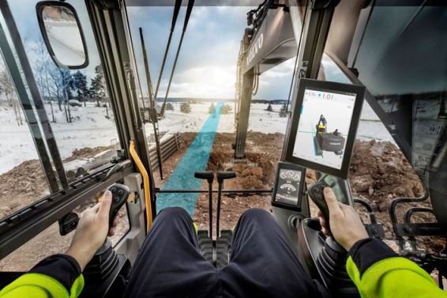
Co Pilot driver statistics project
11/18/2016
Team members:
Vladimir Djukanovic
Leslie Dahlberg
Léa Brunschwig
Eric Engtorp
Fredrik Frenning
Pooria Ghavamian
Hamza Sabljakovic

Slide 2
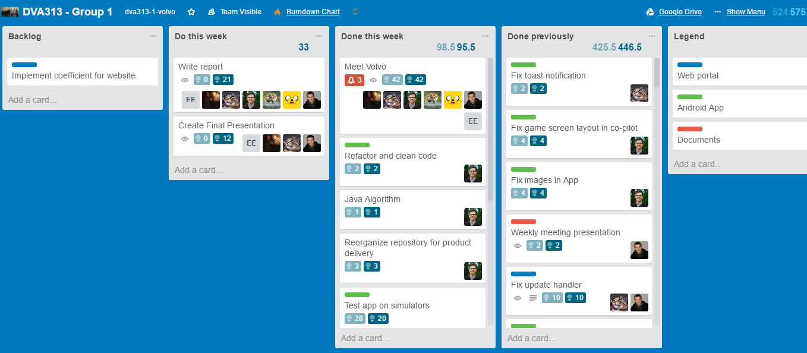
Trello – last week

Slide 3
Last week - establishments
Meet Volvo
Documentation
Weekly meeting presentation
Implementation:
Web application
Remove All from web GUI
Android application
Test app on simulators
Refactor and clean code
Fix navigation with swiping or other navigation style
Save game to local database in Android App
Fix upload function in Android App
Other
Java Algorithm
Reorganize repository for product delivery

Slide 4
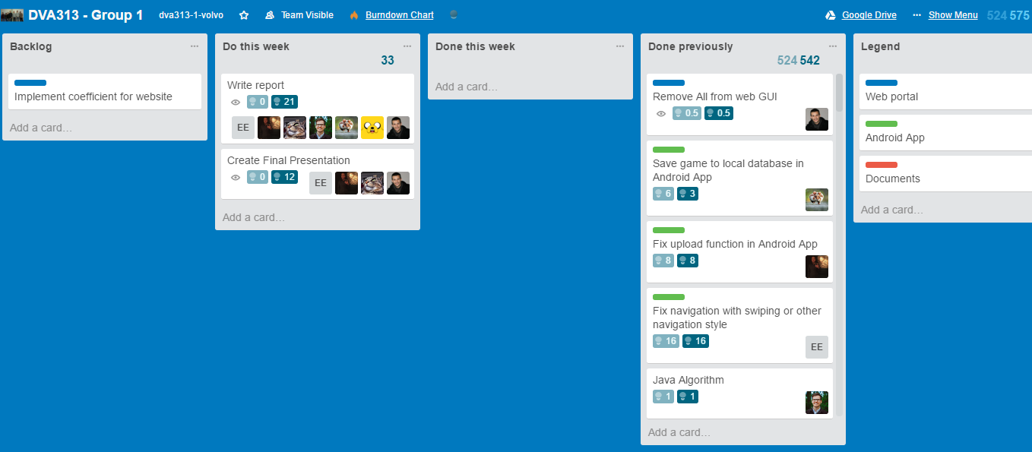
Trello – following week

Slide 5
Plan for following week
Documentation
Improve previous documentation
Write report
Create final presentation

Slide 6
Obstacles
Simulators (Oryx update)

Slide 7
Worked hours
Name | Last week | Total
Vladimir Djukanovic | 14.5 | 108.5
Hamza Sabljakovic | 14 | 107.5
Léa Brunschwig | 14.5 | 86
Eric Engtorp | 12.5 | 95.5
Fredrik Frenning | 14 | 106
Pooria Ghavamian | 12.5 | 102.5
Leslie Dahlberg | 18 | 112

